Slide 1

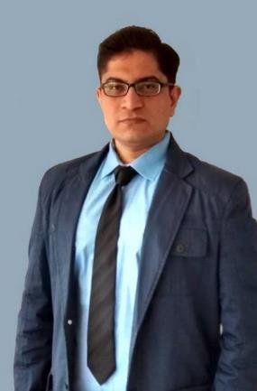
Theory +Economic Survey Vol.2 + Vol.1 + Budget 2016
1.Banking Finance
6.HRD
2.Budget-Fiscal Policy
3.BoP
4.Sectors of Economy
5.Infra
V2C2-Pub.Fin; V1C3-JAM
V2C3-Monetary mgmt+FI
V2C4-External sector
V2C5-Price,Agri.; V2C6,7
V2C8-Paris Summit, Energy
V2C9-Social infra.
V1C4-Agri ; V1C9-Fertilizer
V1C5-mother-child
V1C6-bounties; V1C7-Fiscal Cap
V1C8-PTA
V1C2-Chakravy; V1C10-Labour
V1C11-Powering 1 India
B1. Financial Sector Reforms
B2. Fiscal Discipline
B3. Tax Reforms; B4. Ease of
B5. Agro: 2x farmer income
B6. Rural infra-employment
B7. Infrastructure
B8. Social Sector & healthcare
B9. Education, Skills, Jobs
V2C1- Chakravyuh challenge
V1C1- Twin Balancesheet
IYB:7-Commerce

Slide 2
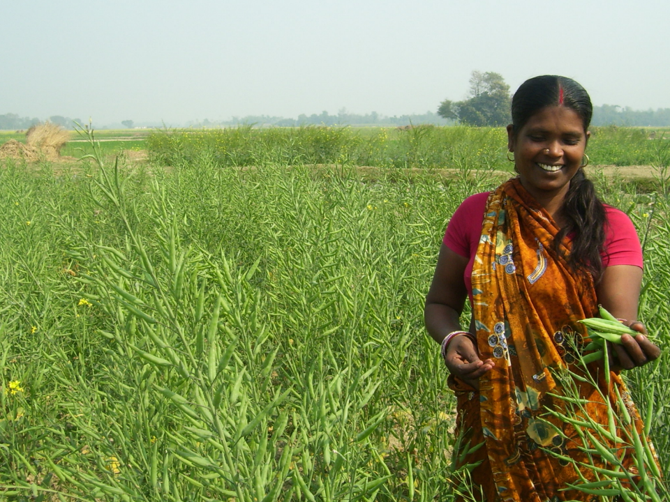
Pillar #4: Sectors of Economy ► Agriculture
Seeds, Irrigation, Fertilizer, Pesticides
Diversify
Credit, Insurance, Marketing
Husbandry
More from Less
$$
organic, pulses
Ranking
Budget’16

Slide 3
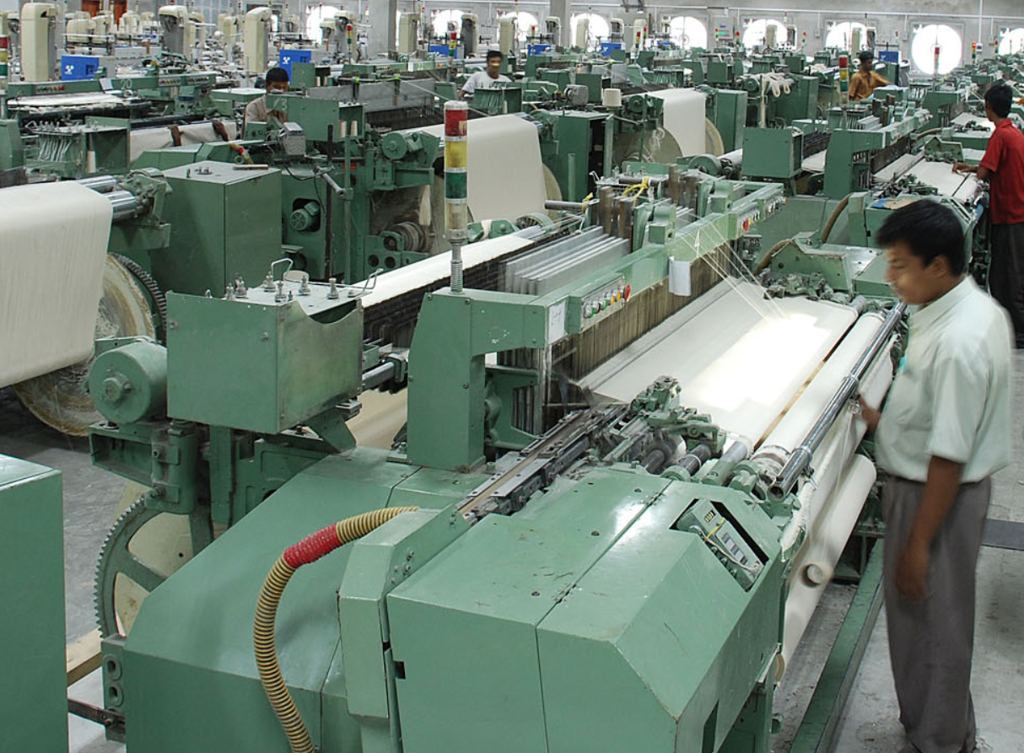
Pillar #4 ► Sectors of Economy ► MFG
Unemployment Types
DPP-2016
Textile Shift
Startups
Regulatory Cholesterol
EPF-Reforms in Budget’16

Slide 4
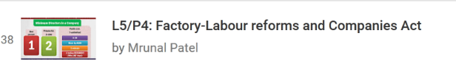
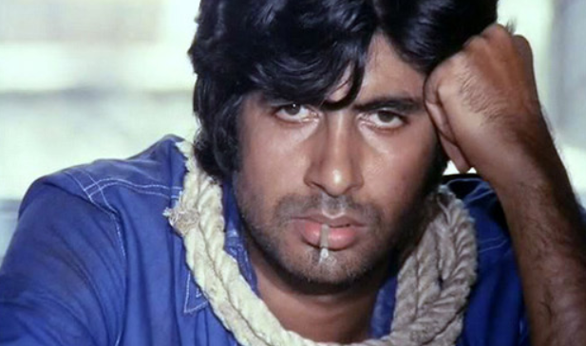

Labour
SELF STUDY

Slide 5
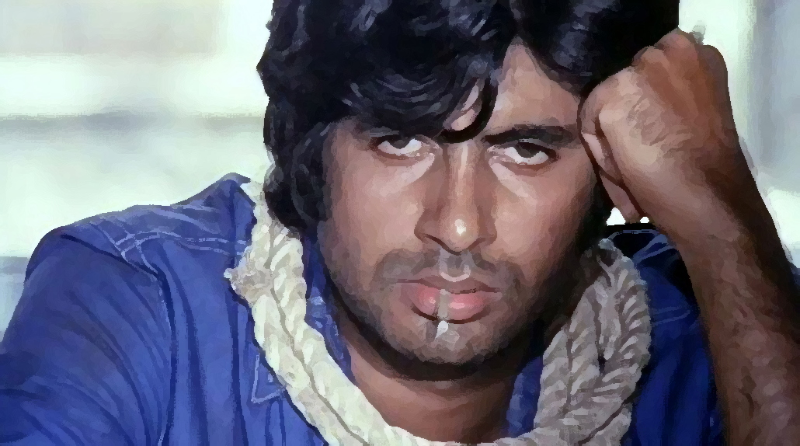
“Involuntary” unemployment: Types of
Cyclical
recession, “Pink slips”
Frictional
Switching between jobs.
Disguised
removing worker = NO ▼ production ; agri, family
Seasonal
Agri, labourer, salt-pan, sugar mills, ice-factory,
Under-employment
B.Com farmer, B-Tech Bank clerk, Dental-DySO
Educated
“not doing anything” OR under-employed
Preparing UPSC/GPSC
Technological
replacing men with machines, textile/IT
Open / structural
lack of jobs.
1st World
Notes:
Educated unemployment occurs because
Rapid expansion of Mass-education
Emphasis on general rather than vocational education.
Both right
Both wrong

Slide 6
UPSC’s CDS-2013
When productive capacity of the economy is inadequate to create sufficient jobs, it's called ____ unemployment.
Seasonal
Structural
Disguised
Cyclical

Slide 7
NSSO: definitions of unemployment
Usual Principal Status
Unemployed for majority of the year
Current Weekly Status
If not even 1 hr work in a week
If not even 1 hr work in a day.
Current Daily Status
Unemployment Rate
# of unemployed / labour force (NOT Total population)
Notes:
Unemployment rate is defined as the number of persons unemployed as a proportion of the labour force (persons who are either ‘working’ or ‘seeking or available for work’), not the total population.

Slide 8
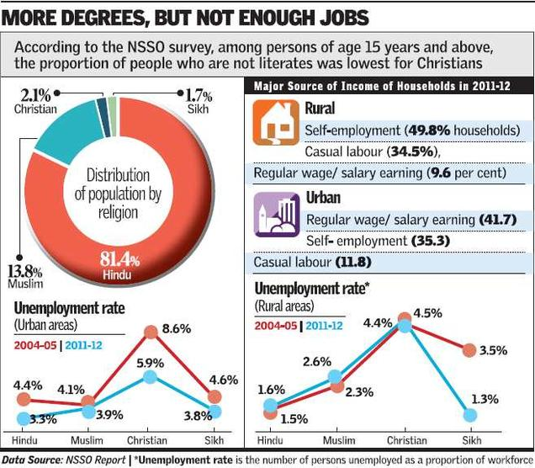
2016, Feb NSSO report, theHindu infographics

Slide 9

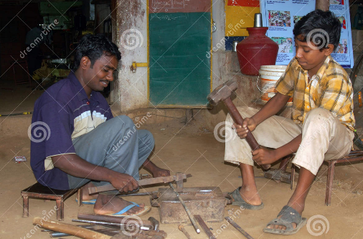
NSSO-09: Total 46.5 cr Total employed

Slide 10
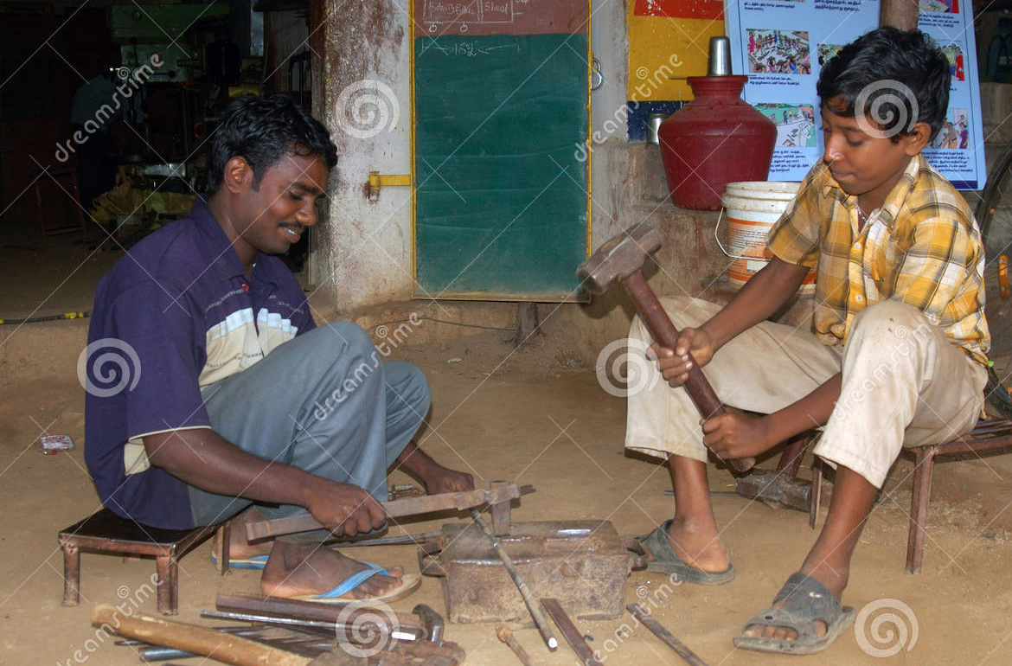
“unorganized” sector
Not covered in ASI
Home based, Self-employed
not “registered” under any law (factories act, shop-establishment act, plantation act, PSU, Cooperative, limited companies…)
Owned/operated by one / few people
Labour relation- casual/social/family
Regular accounts/employee record..No
Division between labour and capital
Poverty ▼
Under-employment ▲
Disguised Unemployment ▲

Slide 11
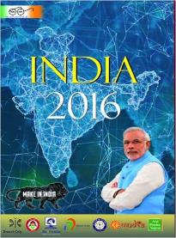
Yearbook Ch.21
Unorganized sector worker is not protected under …
Employee’s Compensation Act, 1923
Industrial Disputes Act, 1947
Employees’ State Insurance Act, 1948
EPF Act, 1952
Maternity Benefit Act, 1961
Payment of Gratuity Act, 1972
ALL OF ABOVE

Slide 12
Unorganized worker
Law
Covered under Unorganized sector workers’ social security act-2008.
National, state level boards
health-disability-maternity coverage; Skill, pension

Slide 13
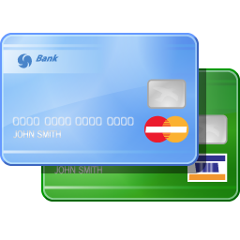
UWIN smart card
Schemes
2014:- UWIN- Unorganised Workers’ Identification Number (UWIN) scheme
smart card with mobile # & bank details
For Rashtriya Swasthya Bima Yojana (RSBY) and Aam Aadmi Bima Yojana (AABY), Atal Pension Yojana, Pradhan Mantri Suraksha Bima Yojana and Jeevan Jyoti Bima Yojana.
~90% of workforce - unorganized. Labour ministry- give to all; finmin- very expensive, give per household.

Slide 14
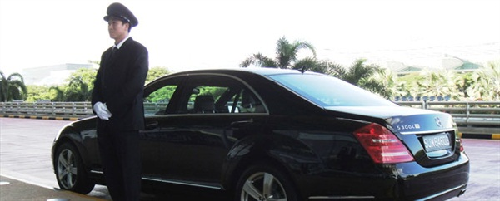

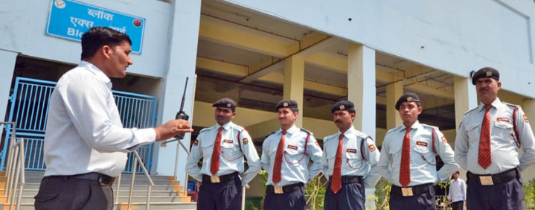
“Informal” worker= No formal agreement with Employer
Within MNC
Not “unskilled” but outside formal education system
Casual wage employment
Provided by Contractor”
Notes:
Informal job can be within formal sector too- e.g. gardener for MNC building
Informal job: not governed by state laws or collective agreement between worker & employer.
Can be causal wage employment (Mazdoor in road/building)
Can be contract job (Teamlease)
Not “unskilled” but outside formal education system
Although “unorganized workers’ social security act 2008” to protect

Slide 15
Labour ministry Classification- informal/unorg. labour
Occupation-wise
Small and marginal farmers, landless agricultural labourers, share croppers, fishermen, those engaged in animal husbandry, beedi rolling, labeling and packing, building and construction workers, leather workers, weavers, artisans, salt workers, workers in brick kilns and stone quarries, workers in saw mills, oil mills
Nature of Employment
Attached agricultural labourers, bonded labourers, migrant workers, contract and casual labourers
Specially distressed categories:
Toddy tappers, Scavengers, Carriers of head loads, Drivers of animal driven vehicles, Loaders and unloaders
Service categories:
Midwives, Domestic workers, Fishermen and women, Barbers, Vegetable and fruit vendors, News paper vendors etc.
Misc.
cobblers, Hamals, Handicraft artisans, Handloom weavers, Lady tailors, Physically handicapped self employed persons, Rikshaw pullers, Auto drivers, Sericulture workers, Carpenters, Tannery workers, Power loom workers and Urban poor.

Slide 16
Pillar #4 ► Sectors of Economy ► MFG
Unemployment Types
DPP-2016
Textile Shift
Startups
Regulatory Cholesterol
EPF-Reforms in Budget’16

Slide 17


Reaping demographic dividend
Can informal sector create such jobs?
No protection against accident, disability, job loss
Indian Economy must create “Good” jobs
Safe
Pay well
Encourage Productivity
Promotion, Pay rise?
Informal jobs..x

Slide 18
Indian economy must create “good” jobs in “FORMAL SECTOR”
Regulatory cholesterol
1.EPF
2.IDA
Safe
Pay well
Encourage Productivity
Formal Sector Jobs

Slide 19

Cholesterol
Science
Lipid, synthesized in the liver, available in food as well
Required for cells, steroid hormones & Vit.D synthesis
High level= deposited on arteries (heart to organ)
Congested arteries=pain, attack
LDL-low density lipoproteins=bad;
HDL=good, carries the bad type to the liver for elimination.
Home work: What is Angina? Why aspirin used in heart disease? What is bypass surgery?

Slide 20
Science: Incorrect statement
Cholesterol is a lipid, mainly synthesized in liver.
High level of Cholesterol blocks both arteries and veins, leading to heart attack.
L.D.L (=bad) Cholesterol is beneficial for health, as it flows easily through blood vessels owing its low density.
Incorrect Statements:
(A) Only 1 and 2 (b) Only 2 and 3
(C) Only 1 and 3 (d) All of them

Slide 21
Indian economy must create “good” jobs in “FORMAL SECTOR”
Regulatory cholesterol
1.EPF 2. IDA
Safe
Pay well
Encourage Productivity
Formal Sector Jobs

Slide 22
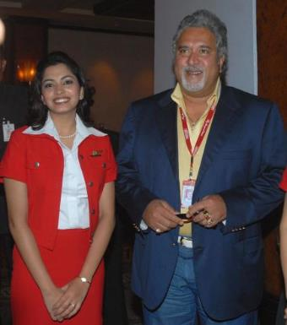
EPF= “regulation induced tax/ cholesterol”
Liquidity problems
EPF= EEE status But, 15k/p.m. =1.8/pa not in IT-bracket,
less take home salary ☹
Until recently, no UAN portability
Better we work without formal agreement. Win-win for both of us!!
Transaction cost high
Had to maintain paper-accounts (until LIN came)
“managing inspectors”
EPF Administrative charges >> MF
Salary upto 15k
12% contribute
Employer
12% contribute
8⅓ EPS
3⅔ EPF

Slide 23
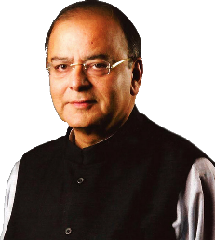
Budget 2016: using EPF to create “Formal Jobs”
Salary upto 15k
12% contribute
Employer
12% contribute
8⅓ EPS
3⅔ EPF
We’ll pay the “ORANGE” Part for 1st 3 years. (salary upto 15k)
Employer 30% deduction for 3 years (salary upto 25k)

Slide 24
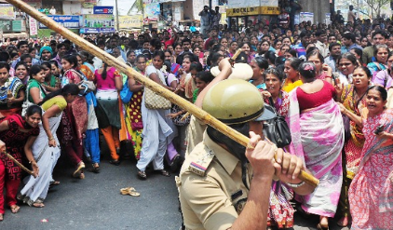
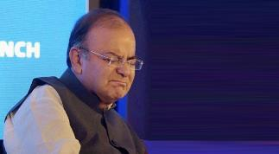
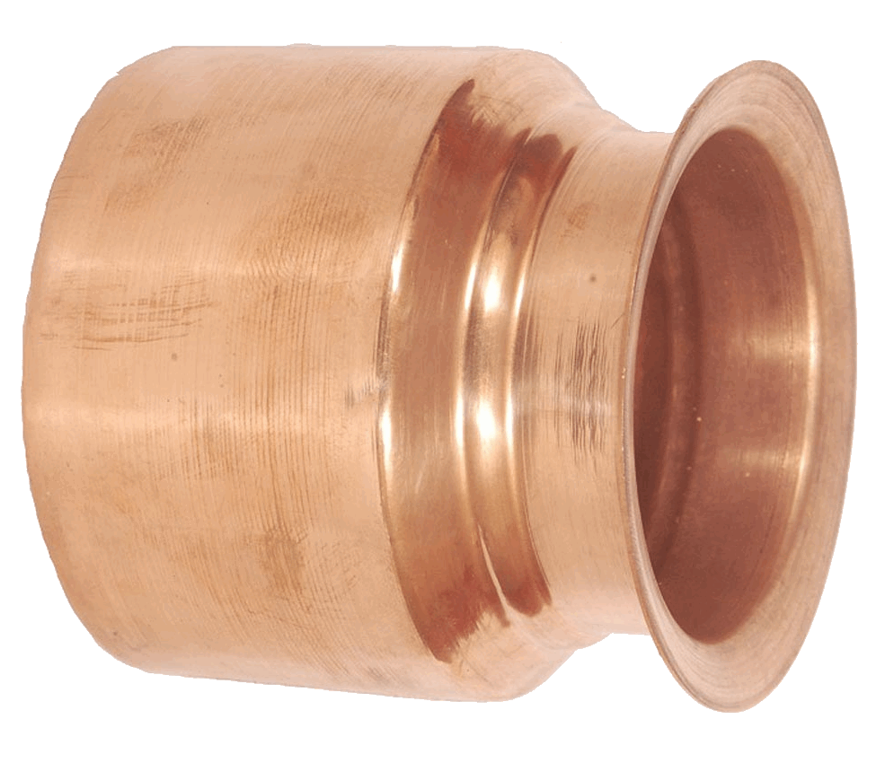
Budget 2016: new proposals on withdrawl
Can’t withdraw, if unemployed for more than 2 months.
Salary upto 15k
12% contribute
Employer
12% contribute
8⅓ EPS
3⅔ EPF
Retirement Age increased from 55 to 58
Never mind. Forget it. we take this proposal back
14th April 2016

Slide 25
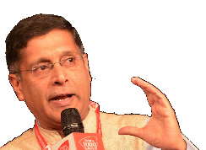
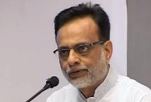
Tax treatment given to PPF (15 years)
Exempt
$ deposited
Exempt
Interest earned
Exempt
$ withdrawn (Principal + Interest)
Reality
Exempt
$ deposited
Exempt
Interest earned
TAX
$ withdrawn (Principal + Interest)
Survey suggested
If this is done for all small savings schemes & PPF= Rs. 12k crore revenue for govt.
=fiscal deficit ▼
=infra/welfare ▲
+more NPS subscribers
Revenue Secretary Hasmukh Adhiya
PPF still continue to exempt, even after budget 2016.

Slide 26
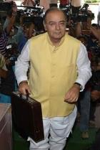

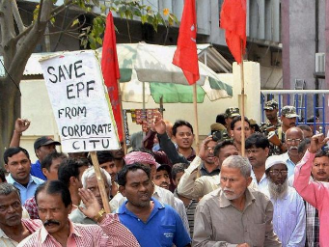
Budget 2016: EPF tax provision
60% of withdrawl taxable
On contribution after 1/4/16
But NA if salary <15k/pm
Exempt
$ deposited
Exempt
Interest earned
TAX
$ withdrawn (Principal + Interest)
As Survey suggested
60% of withdrawal taxable
But only “INTREST” PART
(1st March 2016)
Never mind. Forget it. we take this proposal back
14th April 2016

Slide 27
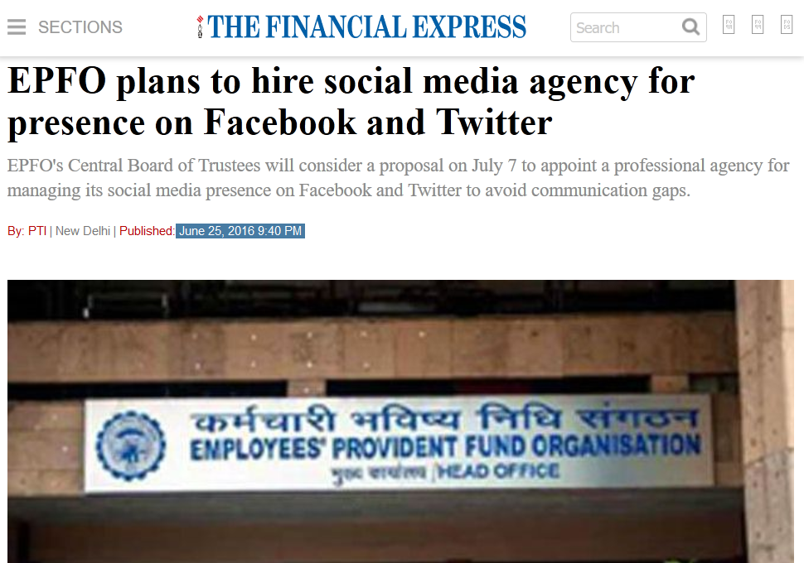
Mains GS2, GS4: Importance of communication in policy making

Slide 28
EPFO- investment norms (out of 8.5l Cr. Corpus)
So far only 5%, that too in SBI –MF and ETF
Max. limit 65% from the incremental corpus i.e. new fund received in current fiscal year (~1.12lc)
=less than optimal return on investment
=Financial repression
Infra, Highway & C-Bonds

Slide 29

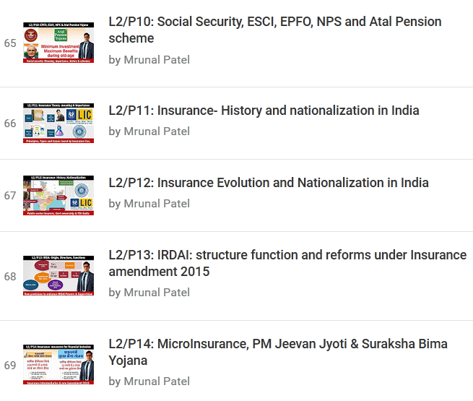
Self Study: Economy► Social security L2/P10 to 14

Slide 30
Indian economy must create “good” jobs in “FORMAL SECTOR”
Regulatory cholesterol
1.EPF 2. IDA
Safe
Pay well
Encourage Productivity
Formal Sector Jobs

Slide 31
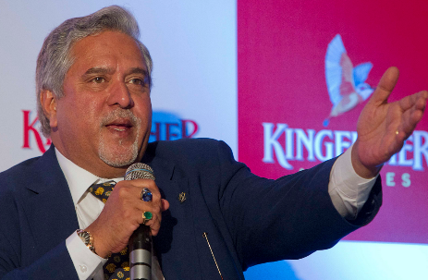
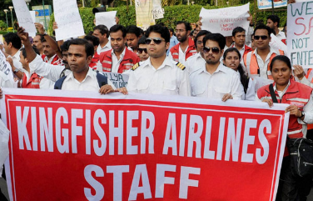
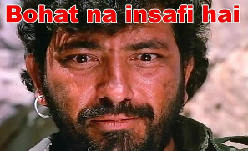
Industrial disputes act (IDA): 100/> workers in firm
But what if there is
New labour saving Machine/technology?
Emergency foreign contract?
Low profitability?
Before retrenchment
advance notice to workers
State govt. approval
Employer must give Advance notice before changing office hrs, holiday norms etc.
Notes:
” the termination by the employer of the service of a workman for any reason whatsoever, otherwise than as a punishment inflicted by way of disciplinary action, but does not include -
firm >100 workers, Government approval to retrench
new labour-saving machinery.
(i) the employee has been given three months’ notice indicating the reason for retrenchment and the period of notice, and (ii) the prior permission of the concerned State Government has been obtained for the retrenchment (Section 25N of the IDA).
modifying the wages and other allowances, hours of work rest intervals and leave of a laborer, you need to give him / her at least a 21 days’ notice before. Thus, if you quickly need to redeploy the employees to meet certain time bound targets, you can’t do that. This disallows industrial restructuring and technological upgrading.

Slide 32
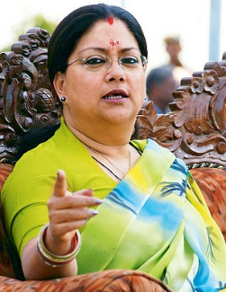
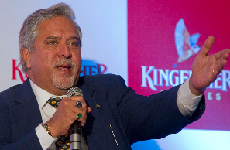
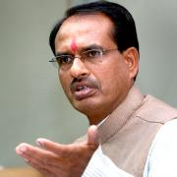
IDA: 100/> workers, state approval needed for retrenchment
Padhaaro Mhare Des..
IDA retrenchment no apply till 100 300 workers
Same in Madhya Pradesh also…after all labour=concurrent list ☺

Slide 33
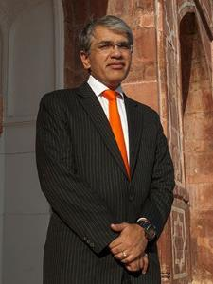
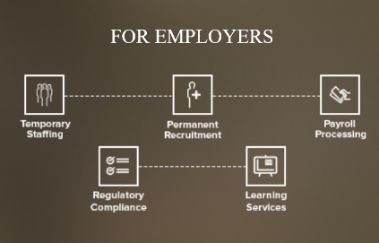

Contract workers in private companies
Staff leasing company
Supply contract staff
Takes care social security / regulatory compliance
Client firm keeps <100 “regular” workers to avoid IDA
Negative
14% more expensive than regular
Human capital /knowledge base lost
Loyalty missing
Firm remain small, economies of scale..x

Slide 34
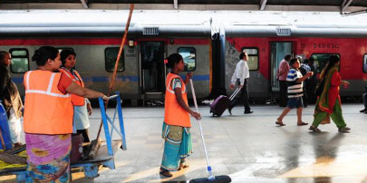
Contract workers in Public sector
To keep R.D.=0 (FRBM) ▲profitability
Outsourced through agency- Peons, drivers, sweepers [7th PC: Min 18k/pm]
Contractual: High skilled professional (6th PC recommended)
Retired Employees

Slide 35
To reap dem.Div, Indian economy must create good jobs
Thanks to regulatory cholesterol
Good job
Informal
1/20th of formal job; collective bargaining..x Cheap formal credit..x
Contract
14% higher than formal; but contractor chows down
Pay well
Safe
Productivity
No social security, insurance against accident, death, disability, job-loss
Loyalty, Human capital lost
No social security
Same as informal
Formal
Yes
Yes
accumulated

Slide 36
Minimum Wages hiked
What’s new
Contract Labour (Regulation and Abolition) Act
Ministry Labour and Employment
Contract workers’ minimum wage- Rs.10,000 per month.
Amount fixed based on CPI and dearness allowance.

Slide 37
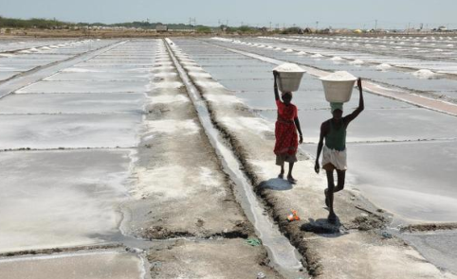
Contract workers: Plight of Salt pan workers
Top producers: US, China, India
Within India: Gujarat 70%, TN (Vedaranyam - C.Rajagopalachari's Dandi), Rajasthan, Andhra Pradesh
State lease► Companies►contractors get >1 lakh salt workers (Agariya)

Slide 38
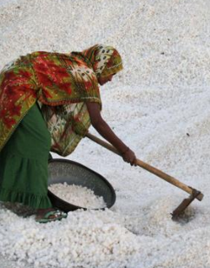
Occupations hazards
Salt pan workers
Skin ulcer/chronic dermatitis
Due to constant exposure to sharp salt crystals. Gloves, boots not given.
Legs abnormally thin- don't burn in pyre ►legs buried in graves, separately.
Pterygia- loss of vision
Exposure to white reflected light & dust. Eye-googles not given.
Hypertension
Salt particles/aerosols inhaled. Masks not given.

Slide 39
Occupations hazards
Salt pan workers
Respiratory disorders
Heat-sealing of salt in plastic bags.
Makeshift hemlets without LPG/kerosene. Firewood used.
Goitre
Non-iodised salt used for domestic consumption.
Home work: Silicosis

Slide 40
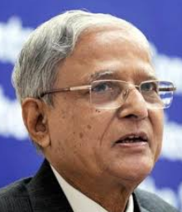
Justice MB Shah (SC-SIT Black money; Guj State law commission)
Salt pan workers
contract labour law, minimum wages act violated
financial exploitation by contractors, money lenders and fair-price shop owners.
No edu, health, No work during monsoon.
Occupational diseases
Art. 21 & 42 violated.
May 1: International labour day- Guj. Government initiated new reforms.
Notes:
Just and human condition

Slide 41

Pillar #4 ► Sectors of Economy ► MFG
Unemployment Types
DPP-2016
Textile Shift
Startups
Regulatory Cholesterol
EPF-Reforms in Budget’16

Slide 42
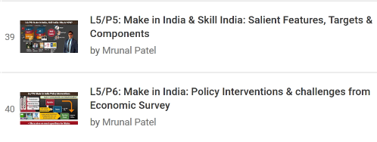

MAKE IN INDIA:
Textile Shift
Startups
DPP-2016
SELF STUDY

Slide 43
Defense Procurement Policy 2016, Dhirendra Singh
Buy Indian
Buy and Make (Indian)
IDDM: Indigenously Designed, Developed and Manufactured
Foreign OEM► Tech. Transfer to Indian firm► Make in India
Buy Global
Foreign company, fully furnished item, no Transfer of Tech.
Government funded, industry funded
Make , Buy and Make (Technical categories)
Procurement Priority
Notes:
Previous was 2013 policy.

Slide 44
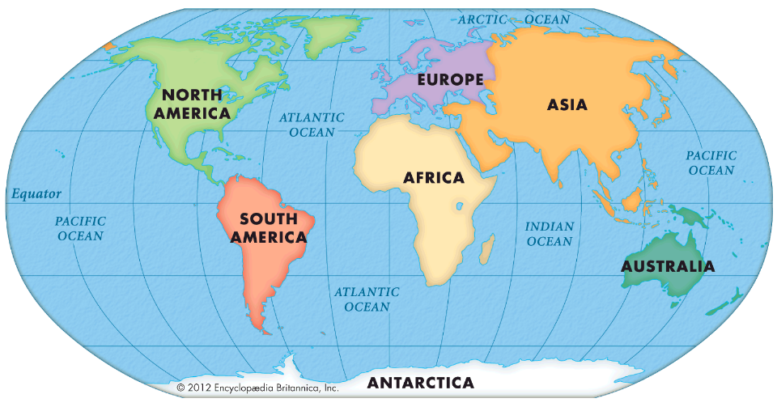
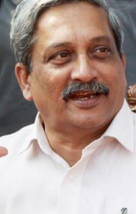
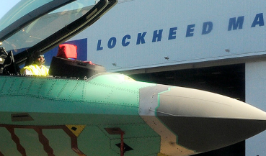
Offset policy in defense procurement
DPP Offset Threshold
Before Rs.300 cr
After Rs.2,000 cr
$$ paid for purchase
Have to invest part of those $$ back in India
Or buy some supplies locally
Benefits
BoP: less outflow
Local vendors get biz, employment

Slide 45
MAKE IN INDIA:
Textile Shift
Startups
DPP-2016

Slide 46
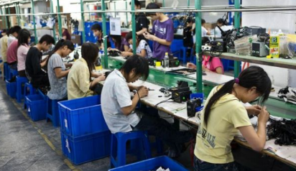
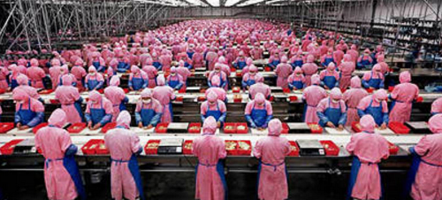
Why more formal jobs, relocation to smaller towns & make in India= beneficial?
China entered mobile mfg. with low tech products like data cables, adapters, earphones
now, Foxconn City in Shenzhen 4.20 lakh workers making iphones
bicycle to car : Start with low-tech, evolve to high tech
Higher GDP, Quality of export basket

Slide 47
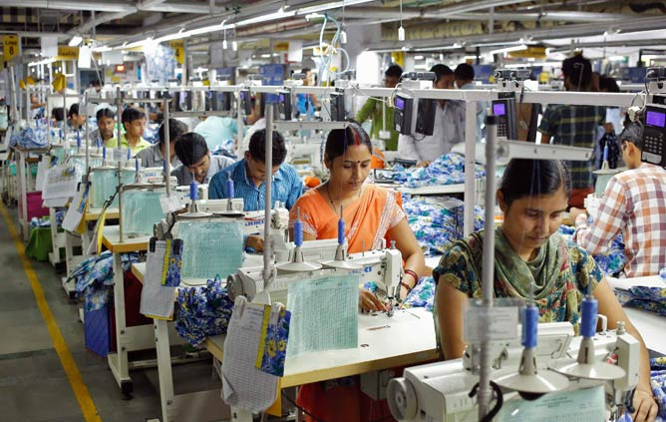
Textile industry: India
>10 cr. Direct indirect employed
50% of them women

Slide 48
India: cotton, labour abundant YET Bangladesh, Vietnam ahead
Organized
Labour is 15x more productive
unorganized
Capital Tied up in Inefficient firms, “EXIT” problem
▲10% in Chinese clothes MRP
12 lakh new jobs in India
World Bank: “Stiches to Riches” report

Slide 49
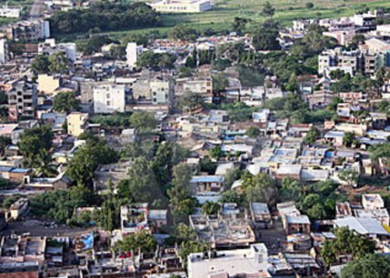

Textile industry should “SHIFT” to smaller towns
Big villages ► towns, rurbanization
▲ female labour force participation=
▲ GDP by 1.4% PA
Agri. Labour ▼
but women friendly industries…x
Textile units: lower wages, land

Slide 50
Textile industry should “SHIFT” to smaller towns
Gainful paid work► self respect
Can spend more on child-edu, health
Positive social externalities
Flexible work hours
Can work @home

Slide 51
MAKE IN INDIA:
Textile Shift
Startups
DPP-2016

Slide 52
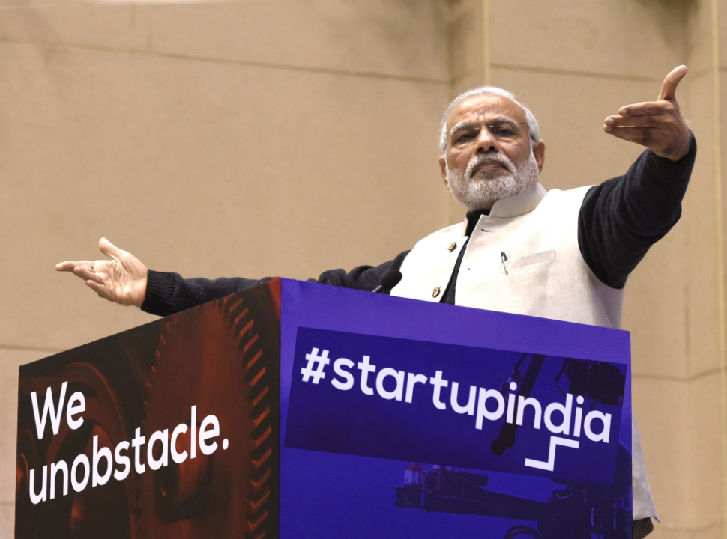
Promotion
Criticism

Slide 53

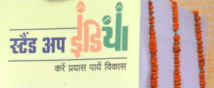


MSME/Start up: Finance / Loan
Through MFI, SCB, RRB..
Shishu: upto 50k
Kishor: >50k-5L
Tarun: >5L-10L
===========
Interest not fixed
CREDIT(+) Approach (Training)
SIDBI► Banks (10k cr.)
Each branch to give atleast
1 loan to SC/ST; 1 to woman Greenfield non-farm Rs.10L-1 Cr.
India Aspiration Fund: Venture capital
SMILE: SIDBI Make in India Loan for Small Enterprises (SMILE)- short term loans for 25-Mk-In-India target MSME industries

Slide 54
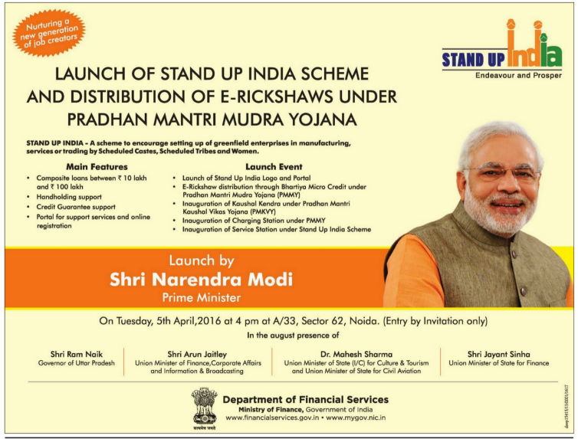

Stand up India: IE ad on Apr-05-2016
Notes:
http://pib.nic.in/newsite/PrintRelease.aspx?relid=134220

Slide 55
Start up: Taxation and regulatory affairs
CGT exempt: selling personal property to invest, VCF- in startup, incubators
Income Tax exemption for three years
Bankruptcy code- Faster exit @90 days
Taxation
Bankruptcy
(Proposed) National Credit Guarantee Trust Company
Rs.500 cr per year x 4 years.
Startup India hub
App: 1 day registration, notification, knowledgebase
Self-certification- air,water pollution, EPF compliance; no inspection for 3 years

Slide 56

UAM-2015
Scheme 4MSME
Under MSME Development Act 2006 for ease of doing business
MSME entrepreneurs: apply online► instant Udyog Aadhaar Number (UAN).
information sought is on self-certification basis and no supporting documents are required.

Slide 57
Start up: Taxation and regulatory affairs
Public Procurement
Relaxed norms of public procurement for start-ups to compete against experienced company.
Patent
Legal support and fast-tracking of patent examination at lower costs,
80% rebate on application fees.
help them commercializing the IPRs

Slide 58

NITI► AIM (500cr.)► SETU (1000 cr.)
Innovation
ATAL centers
Incubation
Self Employment and Talent Utilisation (SETU)
School competition
2016, Feb: Prof Tarun Khanna Committee to workout details
Notes:
Innovation and Incubation
Atal Innovation Mission (AIM)
Self-Employment and Talent Utilization (SETU)- incubation
ASPIRE-2015
A scheme for Promoting Innovation & Rural Entrepreneurs (ASPIRE)- MSME Ministry
For rural and agro based industries
Misc.
7 new research parks similar to IIT Madras' Park
IEC, awards, research parks for students

Slide 59
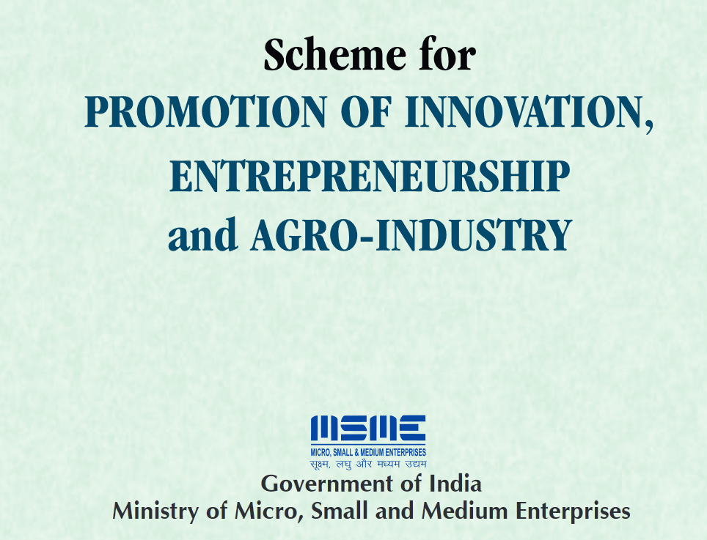
A
ASPIRE-2015

Slide 60
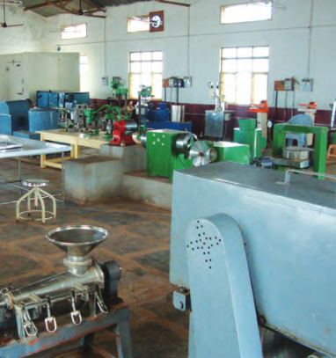
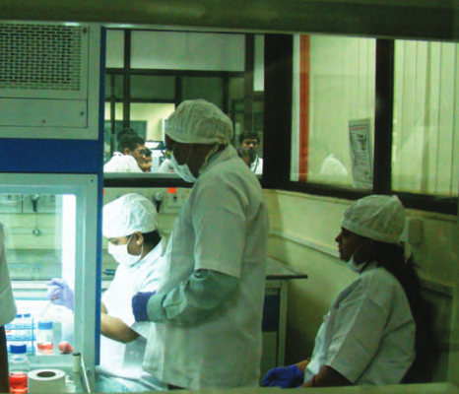

ASPIRE- $$ to setup incubation centre via SIDBI

Slide 61

IPR
Justice Prabha Sridevan-2015
New Policy-2016
TRIPS: WTO
USTR Special-301
DIPP / Commerce
Patent, Design, Trademark, GI (Chronologically)
Department High Edu. / HRD
Copyright Act 1957
Transistor, Integrated circuit etc.
Department IT
Department Agri.
Plant varieties
WIPO’s Madrid Protocol
WIPO’s Lisbon
WIPO Marrakesh, Blind
DIPP became Nodal, 2016 May
Notes:
marakkaesh

Slide 62

Lisbon WIPO __?
British overseas territory
___ SEA?
___ OCEAN?
Marrakesh WIPO ____?

Slide 63

Some Misc. Schemes
MSME
Prime Minister’s Employment Generation Programme (PMEGP)
Credit Guarantee Trust Fund for Micro and Small Enterprises (CGTMSE)
Credit Linked Capital Subsidy Scheme (CLCSS) for Technology Upgradation
Scheme of Fund for Regeneration of Traditional Industries (SFURTI)
Micro and Small Enterprises- Cluster Development Programme (MSE- CDP)
Online Employment Exchange for Industries: to connect jobseekers with job providers
(Bankers) Framework for Revival and Rehabilitation of Disstrssed MSMEs at zonal or district level

Slide 64

Promotion
Criticism
अब थोडा CRITICISE कर लेते है, वरना theHINDU बुरा मान जाएगा.

Slide 65


Startup in app-booking & Ecommerce
Freebies and deep discounts, “CASH burns”
User-base, sales
Valuation methods:
Gross merchandise value
Customer lifetime value
Revenue per click

Slide 66

START UP: CRITICISM of E-commerce/App type biz.
Freebies and deep discounts, “CASH burns”
Angel investors, Seed funding, VCF
User-base, sales
IPO
Ultimately aam-juntaa will subscribe, hoping for large returns, but will lose their money
Valuation methods:
Gross merchandise value
Customer lifetime value
Revenue per click
Ola Cabs- no assets (automobiles), yet valuation Rs.15k+ cr
Snapdeal: no profit since 2010, yet valuation >2 Billion$
Flipkart making Rs.2.33 loss on every Rs. 1 earned, yet valuation >15 billion
Zomato, Urbanladder, Bookmyshow ….all similar cases
Notes:
http://rbsa.in/home/The%20Great%20E-Com%20Crash%20of%202018_.pdf

Slide 67


Signs of trouble

Slide 68
Startup: CRITICISM
IIT/IIMs began complains about deferred / cancelled placements…Startups claim “restructuring”, “delayed funds”
Value creation
Valuation
Extend Startup Geographically
Metropolitans, T1
T2, T3, semi-urban areas
Extend Startup Sector wise
IT, E-Commerce, App-Booking,
agriculture, manufacturing, healthcare and education.;
2 Types of Startup

Slide 69
Pillar #4 ► Sectors of Economy ► MFG
Unemployment Types
DPP-2016
Textile Shift
Startups
Regulatory Cholesterol
EPF-Reforms in Budget’16

Slide 70

For best results..
After Today’s Lecture
Before Next lecture
V2C5-Price,Agri.; V2C6,7
V1C4-Agri ; V1C9-Fertilizer
V1C10-Labour
IYB-2016 Ch. 4, 19
L5: GDP, inflation, IIP;
L2: EPF,insurance
L7: infra
L8: Environment
+ Daily English newspaper: Hindu (1st Preference) OR Indianexpress

